Slide 1
DSA-21: Introduction to Dynamic Programming
Dr. Naveen Kumar
Associate Professor
Amity Institute of Information Technology
Amity University Patna

Slide 2
Dynamic programming (DP) is an algorithmic technique that solves complex problems by breaking them into smaller, overlapping subproblems and storing the results (memoization) to avoid redundant computations.
It optimizes recursive solutions from exponential to polynomial time complexity.
Key applications include Fibonacci numbers, shortest path algorithms (Bellman-Ford, Floyd-Warshall), and edit distance.

Slide 3
The essence of dynamic programming is to avoid repeated calculation.
Often, dynamic programming problems are naturally solvable by recursion. In such cases, it's easiest to write the recursive solution, then save repeated states in a lookup table.
This process is known as top-down dynamic programming with memoization. That's read "memoisation" (like we are writing in a memo pad) not memorization.
One of the most basic, classic examples of this process is the fibonacci sequence. Its recursive formulation is
f(n) = f(n-1) + f(n-2) where n >= 2 and f(0)=0 and f(1)=1.
Program would be expressed as:
int f(int n) {
if (n == 0) return 0;
if (n == 1) return 1;
return f(n - 1) + f(n - 2);
}

Slide 4
The runtime of this recursive function is exponential - approximately O(2^n) since one function call ( f(n) ) results in 2 similarly sized function calls ( f(n-1) and f(n-2)s ).

Slide 5
Core Concepts of Dynamic Programming
Overlapping Subproblems: DP is used when a recursive algorithm revisits the same subproblems repeatedly.
Optimal Substructure: A problem has optimal substructure if an optimal solution to the entire problem can be constructed from optimal solutions to its subproblems.
Memoization/Tabulation: Storing the results of solved subproblems to avoid re-computation.

Slide 6
Approaches
Top-down (Memoization): Start with the original problem and recursively break it down. If a subproblem is solved, store it; if needed again, return the cached result.
Bottom-up (Tabulation): Start from the smallest subproblems (base cases) and fill a table iteratively to compute larger solutions.

Slide 7
Classic DP Problems
Fibonacci Numbers: F(n) = F(n-1) + F(n-2)
Longest Common Subsequence: Finding the longest subsequence common to two sequences.
0/1 Knapsack Problem: Selecting items to maximize value within a weight limit.
Shortest Paths: Algorithms like Bellman-Ford or Floyd-Warshall.

Slide 8
Tabulation and memoization
Tabulation and memoization are two techniques used to implement dynamic programming.
Both techniques are used when there are overlapping subproblems (the same subproblem is executed multiple times). Below is an overview of two approaches.

Slide 9
Memoization
Top-down approach
Stores the results of function calls in a table.
Recursive implementation
Entries are filled when needed.

Slide 10
Tabulation
Bottom-up approach
Stores the results of subproblems in a table
Iterative implementation
Entries are filled in a bottom-up manner from the smallest size to the final size.

Slide 11
Speeding up Fibonacci with Dynamic Programming (Memoization)
Our recursive function currently solves fibonacci in exponential time. This means that we can only handle small input values before the problem becomes too difficult.
For instance, f(29) results in over 1 million function calls!
To increase the speed, we recognize that the number of subproblems is only O(n) .
That is, in order to calculate f(n) we only need to know f(n-1), f(n-2), . . ., f(0) . Therefore, instead of recalculating these subproblems, we solve them once and then save the result in a lookup table. Subsequent calls will use this lookup table and immediately return a result, thus eliminating exponential work!

Slide 12
Each recursive call will check against a lookup table to see if the value has been calculated.
This is done in O(1) time. If we have previously calculated it, return the result, otherwise, we calculate the function normally.
The overall runtime is O(n) . This is an enormous improvement over our previous exponential time algorithm!

Slide 13
const int MAXN = 100;
bool found[MAXN];
int memo[MAXN];
int f(int n) {
if (found[n]) return memo[n];
if (n == 0) return 0;
if (n == 1) return 1;
found[n] = true;
return memo[n] = f(n - 1) + f(n - 2);
}

Slide 14
With our new memoized recursive function, f(29), which used to result in over 1 million calls, now results in only 57 calls, nearly 20,000 times fewer function calls!
Ironically, we are now limited by our data type. f(46) is the last fibonacci number that can fit into a signed 32-bit integer.
Typically, we try to save states in arrays, if possible, since the lookup time is O(1) with minimal overhead. However, more generically, we can save states any way we like.
Other examples include binary search trees (map in C++) or hash tables (unordered_map in C++).

Slide 15
unordered_map<int, int> memo;
int f(int n) {
if (memo.count(n)) return memo[n];
if (n == 0) return 0;
if (n == 1) return 1;
return memo[n] = f(n - 1) + f(n - 2);
}

Slide 16
map<int, int> memo;
int f(int n) {
if (memo.count(n)) return memo[n];
if (n == 0) return 0;
if (n == 1) return 1;
return memo[n] = f(n - 1) + f(n - 2);
}

Slide 17
Both of these will almost always be slower than the array-based version for a generic memoized recursive function.
These alternative ways of saving state are primarily useful when saving vectors or strings as part of the state space.
The layman's way of analyzing the runtime of a memoized recursive function is:
{work per subproblem} * {number of subproblems}
Using a binary search tree (map in C++) to save states will technically result in O(n \log n) as each lookup and insertion will take O(log n) work and with O(n) unique subproblems we have O(n log n) time.
This approach is called top-down, as we can call the function with a query value and the calculation starts going from the top (queried value) down to the bottom (base cases of the recursion), and makes shortcuts via memoization on the way.

Slide 18
Bottom-up Dynamic Programming
Until now you've only seen top-down dynamic programming with memoization.
However, we can also solve problems with bottom-up dynamic programming. Bottom-up is exactly the opposite of top-down, you start at the bottom (base cases of the recursion), and extend it to more and more values.
To create a bottom-up approach for fibonacci numbers, we initialize the base cases in an array. Then, we simply use the recursive definition on array:

Slide 19
const int MAXN = 100;
int fib[MAXN];
int f(int n) {
fib[0] = 0;
fib[1] = 1;
for (int i = 2; i <= n; i++) fib[i] = fib[i - 1] + fib[i - 2];
return fib[n];
}

Slide 20
Of course, as written, this is a bit silly for two reasons:
Firstly, we do repeated work if we call the function more than once.
Secondly, we only need to use the two previous values to calculate the current element.
Therefore, we can reduce our memory from O(n) to O(1) .
An example of a bottom-up dynamic programming solution for fibonacci which uses O(1) memory might be:

Slide 21
const int MAX_SAVE = 3;
int fib[MAX_SAVE];
int f(int n) {
fib[0] = 0;
fib[1] = 1;
for (int i = 2; i <= n; i++)
fib[i % MAX_SAVE] = fib[(i - 1) % MAX_SAVE] + fib[(i - 2) % MAX_SAVE];
return fib[n % MAX_SAVE];
}

Slide 22
Note that we've changed the constant from MAXN TO MAX_SAVE. This is because the total number of elements we need to access is only 3. It no longer scales with the size of input and is, by definition, $O(1)$ memory. Additionally, we use a common trick (using the modulo operator) only maintaining the values we need.
That's it. That's the basics of dynamic programming: Don't repeat the work you've done before.
One of the tricks to getting better at dynamic programming is to study some of the classic examples.

Slide 23
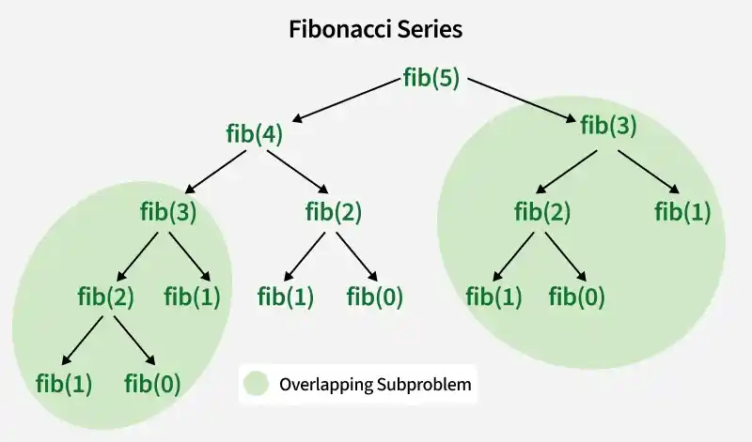
Overlapping Subproblems

Slide 24
class LongestCommonSequence {
// Returns length of LCS for s1[0..m-1], s2[0..n-1]
int lcsRec(String s1, String s2, int m, int n) {
// Base case: If either string is empty, the length of LCS is 0
if (m == 0 || n == 0)
return 0;
// If the last characters of both substrings match
if (s1.charAt(m - 1) == s2.charAt(n - 1))
// Include this character in LCS and recur for remaining substrings
return 1 + lcsRec(s1, s2, m - 1, n - 1);
else
// If the last characters do not match
// Recur for two cases:
// 1. Exclude the last character of S1
// 2. Exclude the last character of S2
// Take the maximum of these two recursive calls
return Math.max(lcsRec(s1, s2, m, n - 1), lcsRec(s1, s2, m - 1, n));
}
int lcs(String s1,String s2){
int m = s1.length(), n = s2.length();
return lcsRec(s1,s2,m,n);
}
public static void main(String[] args) {
String s1 = "AGGTAB";
String s2 = "GXTXAYB";
LongestCommonSequence demo = new LongestCommonSequence();
System.out.println(demo.lcs(s1, s2));
}
}

Slide 25
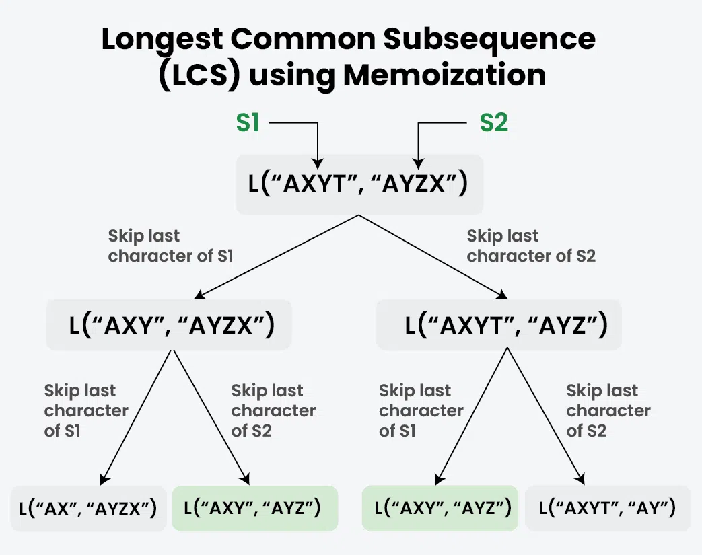

Slide 26
class LongestCommonSequence {
// Returns length of LCS for s1[0..m-1], s2[0..n-1]
int lcsRec(String s1, String s2, int m, int n, int[][] memo) {
// Base Case
if (m == 0 || n == 0)
return 0;
// Already exists in the memo table
if (memo[m][n] != -1)
return memo[m][n];
// Match
if (s1.charAt(m - 1) == s2.charAt(n - 1)) {
return memo[m][n]
= 1 + lcsRec(s1, s2, m - 1, n - 1, memo);
}
// Do not match
return memo[m][n]
= Math.max(lcsRec(s1, s2, m, n - 1, memo),
lcsRec(s1, s2, m - 1, n, memo));
}
int lcs(String s1, String s2){
int m = s1.length();
int n = s2.length();
int[][] memo = new int[m + 1][n + 1];
// Initialize the memo table with -1
for (int i = 0; i <= m; i++) {
Arrays.fill(memo[i], -1);
}
return lcsRec(s1, s2, m, n, memo);
}
public static void main(String[] args) {
String s1 = "AGGTAB";
String s2 = "GXTXAYB";
LongestCommonSequence demo = new LongestCommonSequence();
System.out.println(demo.lcs(s1, s2));
}
}

Slide 27
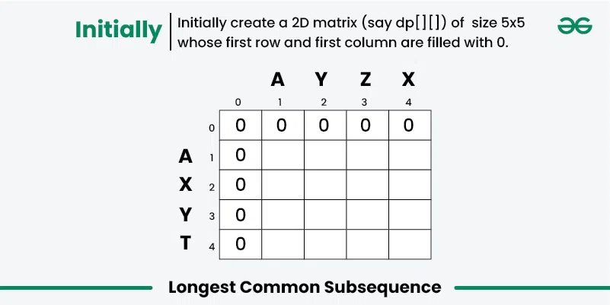

Slide 28
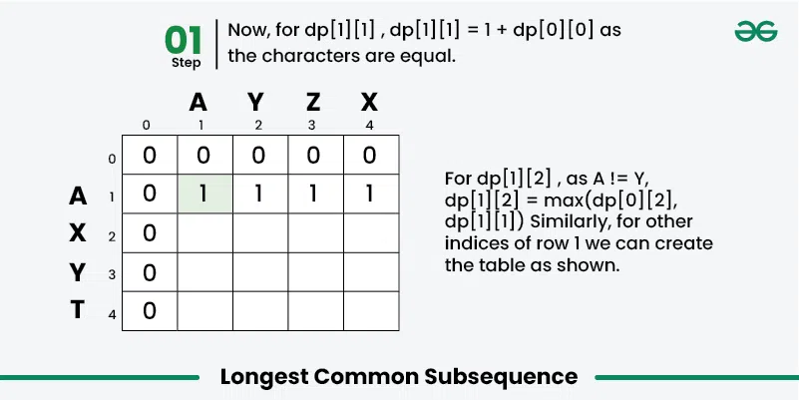

Slide 29
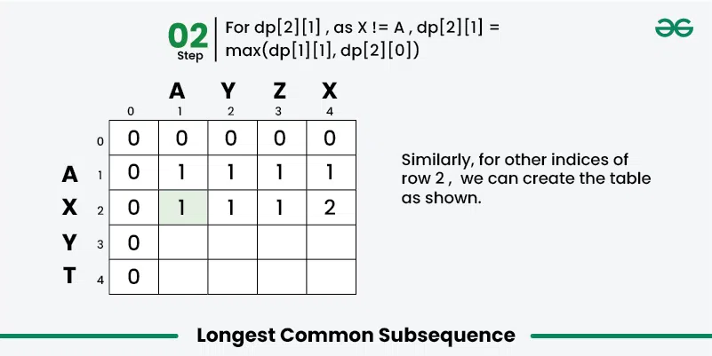

Slide 30
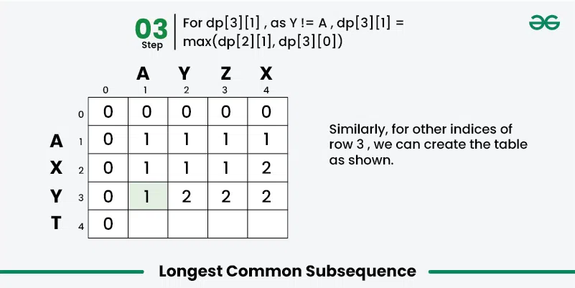

Slide 31


Slide 32
class LongestCommonSubsequence {
// Returns length of LCS for s1[0..m-1], s2[0..n-1]
int lcs(String S1, String S2) {
int m = S1.length();
int n = S2.length();
// Initializing a matrix of size (m+1)*(n+1)
int[][] dp = new int[m + 1][n + 1];
// Building dp[m+1][n+1] in bottom-up fashion
for (int i = 1; i <= m; i++) {
for (int j = 1; j <= n; j++) {
if (S1.charAt(i - 1) == S2.charAt(j - 1)) {
dp[i][j] = dp[i - 1][j - 1] + 1;
}
else {
dp[i][j] = Math.max(dp[i - 1][j],
dp[i][j - 1]);
}
}
}
// dp[m][n] contains length of LCS for S1[0..m-1] // and S2[0..n-1]
return dp[m][n];
}
public static void main(String[] args)
{
String S1 = "AGGTAB";
String S2 = "GXTXAYB";
LongestCommonSubsequence demo = new LongestCommonSubsequence();
System.out.println( demo.lcs(S1, S2));
}
}

Slide 33
0/1 Knapsack Problem
Given two arrays, val[] and wt[], where each element represents the value and weight of an item respectively, also given an integer W representing the maximum capacity of the knapsack (the total weight it can hold).
Put the items into the knapsack such that the sum of values associated with them is the maximum possible, without exceeding the capacity W.
Note: We can either include an item completely or exclude it entirely - we cannot include a fraction of an item.

Slide 34
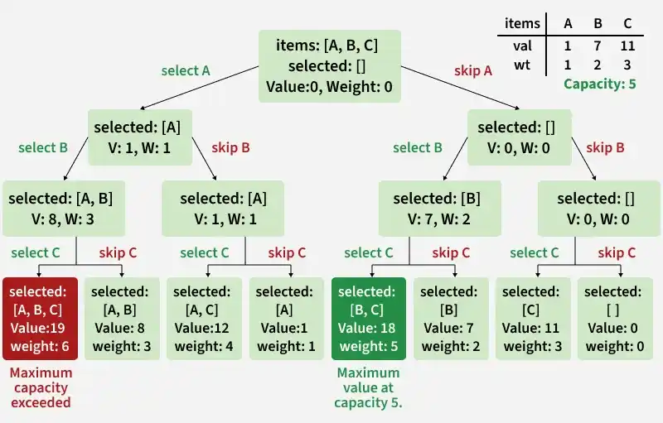

Slide 35
int knapsackRecursive(int W, int[] val, int[] wt, int n) {
// Base Case
if (n == 0 || W == 0) return 0;
int pick = 0;
// Pick nth item if it does not exceed the capacity of knapsack
if (wt[n - 1] <= W)
pick = val[n - 1] + knapsackRecursive(W - wt[n - 1], val, wt, n - 1);
// Don't pick the nth item
int notPick = knapsackRecursive(W, val, wt, n - 1);
return Math.max(pick, notPick);
}

Slide 36
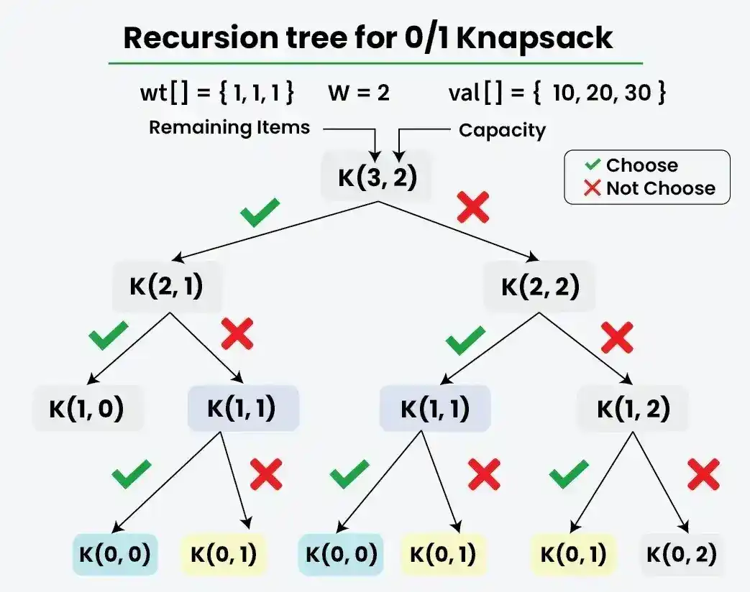

Slide 37
int knapsackTopDown(int W, int[] val, int[] wt, int n, int[][] memo) {
// Base Case
if (n == 0 || W == 0) return 0;
// Check if we have previously calculated the same subproblem
if (memo[n][W] != -1) return memo[n][W];
int pick = 0;
// Pick nth item if it does not exceed the capacity of knapsack
if (wt[n - 1] <= W)
pick = val[n - 1] + knapsackTopDown(W - wt[n - 1], val, wt, n - 1, memo);
// Don't pick the nth item
int notPick = knapsackTopDown(W, val, wt, n - 1, memo);
// Store the result in memo[n][W] and return it
return memo[n][W] = Math.max(pick, notPick);
}

Slide 38
int knapsack(int W, int[] val, int[] wt) {
int n = wt.length; int[][] dp = new int[n + 1][W + 1];
// Build table dp[][] in bottom-up manner
for (int i = 0; i <= n; i++) {
for (int j = 0; j <= W; j++) {
// If there is no item or the knapsack's capacity is 0
if (i == 0 || j == 0) dp[i][j] = 0;
else {
int pick = 0;
// Pick ith item if it does not exceed the capacity of knapsack
if (wt[i - 1] <= j) pick = val[i - 1] + dp[i - 1][j - wt[i - 1]];
// Don't pick the ith item
int notPick = dp[i - 1][j];
dp[i][j] = Math.max(pick, notPick);
}
}
}
return dp[n][W];
}

